Slide 1

Department of Computer Science and Engineering Mtech Artificial Intelligence
Mini Project Review
on
DeepBrain: An Explainable Deep Learning Approach for Brain Tumor Classification Using MobileNetV2
Under the Guidance Presented
of by
Mrs.P.Sandhya G.Ashika Sreya
(asst.Professor) (24L31DAC04)

Slide 2
ABSTRACT
This project presents DeepBrain, a clinically motivated deep learning-based system for automatic brain tumor classification using MobileNetV2 and Grad-CAM visualization. The solution leverages transfer learning with MobileNetV2 and fine-tunes it using a custom training pipeline enhanced with data augmentation, dropout, batch normalization, and L2 regularization layers. The dataset used is categorized into four distinct classes: glioma, meningioma, pituitary tumor, and no tumor, and is split into training, validation, and test sets with image size standardized to 224×224 pixels.
The backend is deployed using FastAPI, exposing endpoints for prediction and PDF generation. The frontend is built with HTML, CSS, and JavaScript, providing a user-friendly interface for uploading images, receiving predictions with class probabilities, and visualizing Grad-CAM overlays for explainability. The model's output is summarized in a downloadable PDF containing the diagnosis, Grad-CAM results, and treatment recommendations for each image.
The model is evaluated using accuracy, confusion matrix, ROC-AUC curves, and classification reports. The system also supports batch image classification, dynamic prediction progress bars, patient name entry, and auto-cleaning of temporary data. This end-to-end application is tailored for clinical use, telemedicine, and educational settings, enabling fast, interpretable, and reliable brain tumor detection.

Slide 3
Brain Tumor
Brain tumors are abnormal growths of cells in the brain that can be benign or malignant. If not diagnosed and treated early, malignant brain tumors can grow rapidly, disrupt normal brain function, and become life-threatening. These tumors originate within the brain tissue and may spread to other parts of the central nervous system. Accurate and early detection of brain tumors is crucial to improving treatment outcomes and survival rates. This project aims to predict the presence of brain tumors by analyzing MRI scan data of patients, using deep learning algorithms. A convolutional neural network (CNN) is trained to classify brain scans into categories such as glioma, meningioma, pituitary tumor, or no tumor, assisting in faster and more reliable diagnoses.

Slide 4
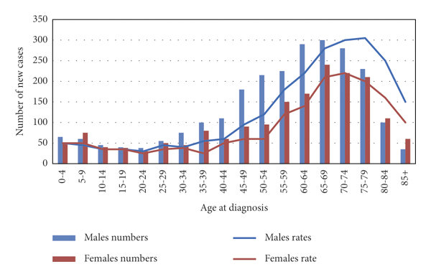
Statistics on Brain Tumor in recent years

Slide 5
EXISTING SYSTEM
There are a number of existing systems for detecting brain tumors, including: Magnetic Resonance Imaging (MRI): The most widely used imaging technique for detecting brain tumors. MRI provides detailed images of the brain’s structure and helps identify abnormalities. However, interpretation depends on radiologist expertise and may miss subtle patterns. Computed Tomography (CT) Scans: CT scans are faster and often used in emergency situations, but offer lower resolution than MRIs and are less effective at detecting small or early-stage tumors. Biopsy: A surgical method to extract brain tissue for analysis. It is invasive and used only after imaging suggests a tumor. Manual Radiologist Diagnosis: Experts analyze MRI or CT scans manually. This approach is prone to human error due to fatigue or limited experience, especially in complex or borderline cases. Traditional Machine Learning Models: Some systems use handcrafted features with classifiers like SVMs or random forests. However, they often lack robustness and generalization across datasets.

Slide 6
PROPOSED SYSTEM
In the proposed system, a deep learning-based approach is used to detect and classify brain tumors from MRI images with high accuracy. The dataset used comprises four distinct classes: glioma, meningioma, pituitary tumor, and no-tumor. Prior to model training, the dataset is preprocessed and augmented using techniques like rotation, zooming, flipping, and rescaling to improve generalization and prevent overfitting.
A MobileNetV2-based Convolutional Neural Network (CNN) is employed, known for its balance of efficiency and accuracy, especially suitable for low-resource environments. The model architecture includes depthwise separable convolutions, batch normalization, and activation layers, followed by global average pooling and dense layers for classification. The model is trained on a well-organized dataset, split into training and testing folders, and achieves more than 93% accuracy, significantly improving upon existing baseline methods.
Enhancements such as Grad-CAM visualizations are integrated into the system to provide explainable AI, highlighting regions of the brain that influenced the classification result. The model also undergoes performance evaluation using classification reports, ROC-AUC curves, and confusion matrices to ensure its reliability and robustness.
Furthermore, a user-friendly Flask web application is built around the model, enabling real-time predictions on uploaded images. Features include multiple image uploads, visual prediction results with ✅/❌ labels, Grad-CAM heatmaps, and downloadable PDF reports, making the system practical for medical professionals and educational purposes.

Slide 7
SYSTEM REQUIREMENTS
Hardware Requirements: Processor : Intel Core i5 or higher RAM : 8 GB minimum (16 GB recommended for faster training) ROM : 512 GB (SSD recommended for faster data access) GPU : NVIDIA GPU with CUDA support (optional but recommended)
Software Requirements: Operating System : Windows 10/11, Linux, or macOS Coding Language : Python 3.7 or above Development Platform : Jupyter Notebook / VS Code / PyCharm Frameworks & Libraries : TensorFlow, Keras, OpenCV, NumPy, Matplotlib, Flask Back-end Dataset : Brain Tumor MRI Dataset (sourced from Kaggle)

Slide 8
PHASES IN MODEL LEARNING
There are totally 4 modules in the current application. They are as follows:
Data Preparation
Model Training and Evaluation
Prediction and Explainability with Grad-CAM
Local Web Application Interface

Slide 9
Data Preparation
The dataset is loaded from organized Training and Testing folders with four brain tumor classes. Images are resized to 224x224 pixels, normalized, and augmented using ImageDataGenerator to improve model robustness.
Model Training and Evaluation
MobileNetV2 is fine-tuned on the prepared data, trained with augmented images, and evaluated using accuracy, classification reports, and ROC-AUC curves to ensure reliable performance.
Prediction and Explainability with Grad-CAM
The trained model predicts tumor presence in new MRI scans, while Grad-CAM generates heatmaps to visually highlight regions influencing the classification, enhancing interpretability.
Local Web Application Interface
A Fast api allows users to upload multiple images, displays predictions with clear labels (✅ healthy, ❌ tumor), and shows Grad-CAM heatmaps for each image, providing an interactive diagnostic tool.

Slide 10
CNN
A convolutional neural network (CNN) is a deep learning algorithm highly effective for image classification and analysis tasks. It consists of multiple layers, such as convolutional layers that extract features, pooling layers that reduce spatial dimensions, activation functions that introduce non-linearity, and fully connected layers that perform final classification.
Key components used in the proposed model include:
Convolutional layers
Depthwise separable convolutions (used in MobileNetV2)
Activation functions (ReLU and ReLU6)
Fully connected (dense) layers
Different types of CNN models commonly used in medical imaging are: LeNet, AlexNet, GoogleNet, ResNet, MobileNet (used in this project), and VGG.

Slide 11
MobileNetV2
MobileNetV2 is a lightweight and efficient convolutional neural network architecture introduced by Google in 2018. It is specifically designed for mobile and embedded vision applications, where computational resources are limited. MobileNetV2 improves upon the original MobileNet by using inverted residuals and linear bottlenecks, enabling faster and more efficient inference without sacrificing accuracy.
Benefits of MobileNetV2 include:
Lightweight and low-latency inference
Reduced number of parameters
High accuracy on image classification tasks
Ideal for deployment on mobile and edge devices
Variants and Applications of MobileNet include:
MobileNetV1: The original lightweight CNN model
MobileNetV2: Improved architecture with better accuracy and efficiency
MobileNetV3 (Small and Large): Optimized for even better performance using neural architecture search
Widely used in medical imaging, object detection, and real-time AI on mobile platforms

Slide 12
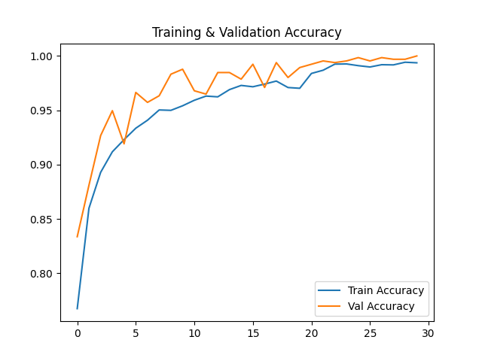
RESULTS
Confusion Matrix
Class | TP | FP | FN | TN
glioma | 149 | 0 | 2 | 505
meningioma | 164 | 3 | 0 | 489
notumor | 192 | 0 | 0 | 464
pituitary | 148 | 0 | 1 | 507
Accuracy

Slide 13
FUTURE ENHANCEMENT
Add real-time webcam-based MRI image capture
Integrate email notification with attached PDF reports
Implement user authentication (login/signup system)
Enable historical prediction tracking per patient
Add a confidence threshold slider in the frontend
Enable multi-language support (frontend & reports)
Allow manual annotation or correction by doctors in the app
Provide Grad-CAM audio explanation using text-to-speech
Support switching between different trained model versions
Add feedback button to flag wrong predictions for retraining
Integrate with hospital PACS/RIS/DICOM systems
Include clinical treatment suggestions in PDF reports
Make the frontend responsive and mobile-friendly
Enhance dark/light mode with theme persistence
Add dashboard for usage analytics and model performance
Daily usage
Model accuracy trends
Common misclassified classes
Patient volume per tumor type

Slide 14
CONCLUSION
The integration of deep learning techniques in brain tumor classification has significantly enhanced the accuracy and efficiency of diagnostic processes. By utilizing convolutional neural networks (CNNs), particularly the MobileNetV2 architecture, the system effectively analyzes complex MRI brain images to distinguish between glioma, meningioma, pituitary tumors, and healthy brains. This approach automates the detection process, minimizes human error, and supports radiologists with fast and reliable predictions. The use of Grad-CAM further adds explainability by visually highlighting tumor regions in the images, thereby increasing trust and interpretability of the model’s decisions. Unlike traditional methods, this system benefits from transfer learning, allowing high performance even with limited data. Overall, this deep learning-based application offers a non-invasive, efficient, and accurate solution for early brain tumor diagnosis, potentially improving clinical workflows and patient outcomes.

Slide 15
Thank You

